Slide 1

Financial Literacy App
https://github.com/prjbhuva/SPM-Group-11-Financial-Literacy-App
"Empowering Financial Confidence Through Interactive Learning and Real-World Application"
Group 11:
Priyansh Bhuva 40269498
Harshvardhansingh Rao 40268567
Pulkit Bansal 40321488
Nihal Galani 40263265
Tanveer Reza 40292971

Slide 2
Introduction: Revolutionizing Learning for the Digital Age
Vision: By combining education with practical tools, FinWise aims to foster a generation of financially confident individuals equipped to make informed decisions, avoid debt traps, and achieve long-term financial stability.
Financial illiteracy impacts over 66% of adults worldwide, leading to poor decisions, debt traps, and lost opportunities. Millennials alone lose an average of $1,200 annually due to a lack of financial knowledge.
Problem: In today’s fast-paced financial landscape, individuals face increasingly complex decisions regarding saving, investing, and debt management. Traditional education often fails to equip people with the necessary skills to navigate these challenges effectively​.
Solution: Financial Literacy App bridges the gap between knowledge and action through Interactive Learning Modules, Real-Time Portfolio Simulations, Personalized Learning Paths.

Slide 3

Market Justification: Tapping into Fintech Trends
Market Analysis Findings:
Widespread Financial Illiteracy: A recent OECD survey across 39 countries revealed that only 18% of adults possess high financial literacy levels, with significant disparities among nations.
Growing Demand for Financial Education: The global personal finance software market was valued at USD 1.08 billion in 2022 and is expected to grow at a CAGR of 5.1% from 2023 to 2030, indicating a rising demand for financial education tools.
Digital Adoption and E-Learning Growth: The online education market is projected to reach USD 185.2 billion in 2024, with an annual growth rate of 8.57%, reflecting the increasing shift towards digital learning platforms.

Slide 4

Project Relevance and Potential Success: Harnessing Market Trends for Success
Addressing a Global Challenge:
Financial illiteracy affects over 66% of adults globally, leading to poor financial decisions, increased debt, and missed opportunities for wealth creation. This underscores the urgent need for accessible and effective financial education tools​.
Empowering Underserved Demographics:
By addressing the demand for interactive and adaptive learning solutions, our project meets the evolving needs of educators, students, and educational institutions in the digital age.
Innovative Features:
Unlike competitors, FinWise combines education, news and simulation in one platform, creating a holistic approach to financial literacy.
Revenue Potential:
Freemium and premium subscription models, coupled with partnerships with financial institutions and educational organizations, ensure a strong and diversified revenue stream.
Strong Market Demand:
The personal finance app market is growing rapidly, with projections estimating a CAGR of 25.4% from 2023 to 2030​. The increasing focus on financial wellness by individuals and organizations ensures a sustained interest in tools like FinWise.

Slide 5
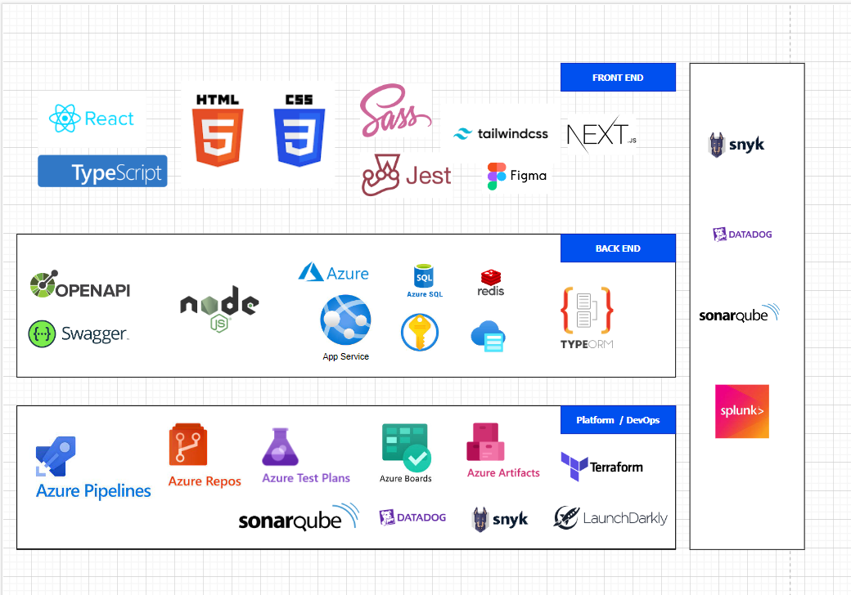
Feasibility Study
Economic Feasibility
Expense Category | Estimated Cost ($)/yearly | Expense Category | Estimated Cost ($)/yearly
Development Costs | $600,000 - $1,000,000+ | Initial Product Rollout | $30,000
Testing Costs | $150,000 | AWS Costs | $35,000
Tech infrastructure | $50,000 | Storage Costs | $10,000
Office Space | $100,000 | 3rd Party Integration Costs | $15,000
Tech Equipment | $75,000 | Licensing and Legal Fees | $25,000
Training | $20,000 | Deposits | $15,000
Research and Development | $50,000 | Travel | $10,000
Marketing | $22,000 | Buffer Allowance | $50,000
Maintenance and Support | 20% - 30% of development cost | Employee Payroll | $90,000 - $110,000
Tech Stack: Frontend: React for web and React Native for mobile, ensuring seamless cross-platform compatibility. Node.js for event-driven architecture, ideal for handling large datasets and real-time interactions.
Third-party Integrations: APIs such as Plaid for secure financial account linkage and Alpha Vantage for real-time financial data​.
Security Measures: Multi-factor authentication, TLS encryption, and data encryption at rest to protect sensitive financial data​.
User-Centric Design: Intuitive UI/UX to engage users across varying financial literacy levels, supported by gamified elements and interactive modules​.
Scalability: Built with Docker and a microservices architecture for handling user growth and data complexity​.

Slide 6
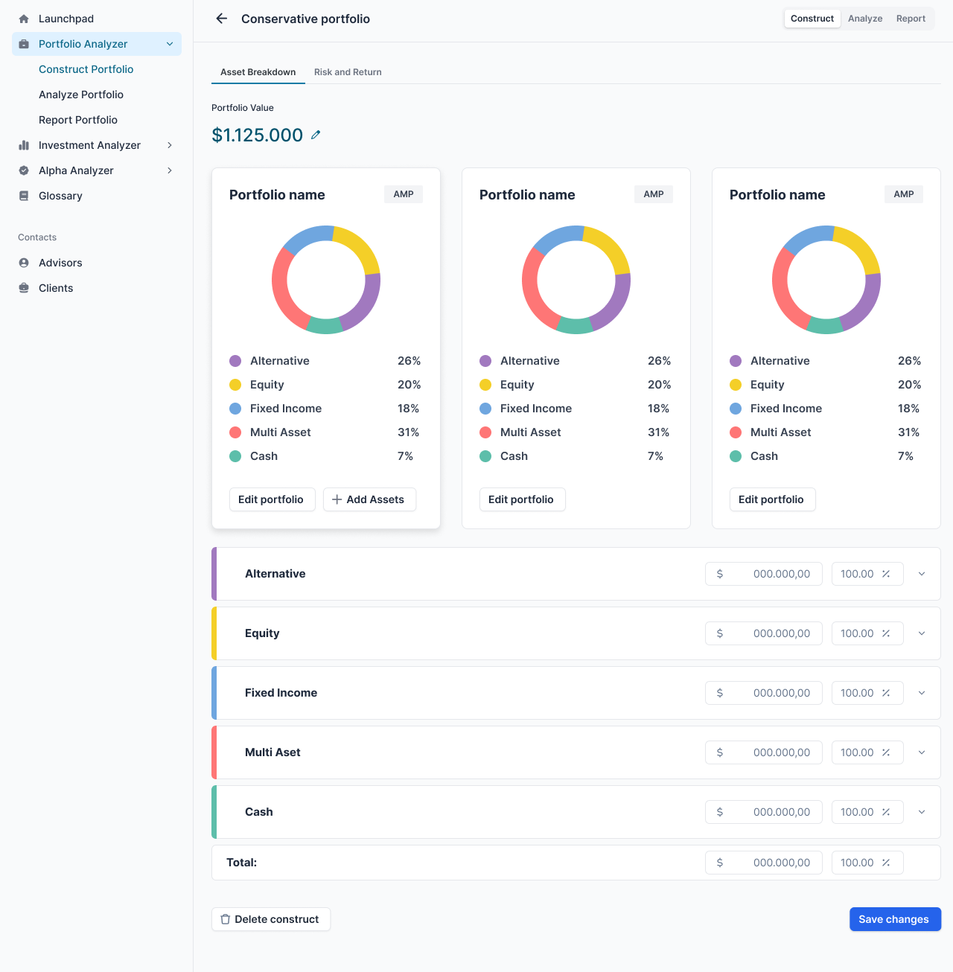
Solution Highlights: Transforming Financial Education
Interactive Learning Modules:
Overview: Comprehensive, gamified educational modules covering essential financial concepts like budgeting, saving, investing, and credit management.
Impact: Users can engage with financial education in a practical, enjoyable format.
Real-Time Portfolio Simulation:
Overview: Tools for creating, managing, and testing virtual investment portfolios with real-world financial data from integrations like Alpha Vantage.
Impact: Empowers users to practice investment strategies risk-free.
AI-Powered Personalization:
Overview: Customized financial guidance based on user behavior, goals, and financial health assessments.
Impact: Delivers tailored advice, ensuring relevance to individual financial situations, increasing engagement and effectiveness​.
Secure Financial Integration:
Overview: Integrates with user bank accounts via secure APIs like Plaid for real-time tracking of spending and saving habits.
Impact: Offers a holistic view of personal finances, improving the practical application of learned financial skills​.
Gamified Progress Tracking:
Overview: Features like quizzes, leaderboards, badges, and achievement tracking.
Impact: Motivates users to engage consistently, transforming learning into an interactive and rewarding experience​.

Slide 7
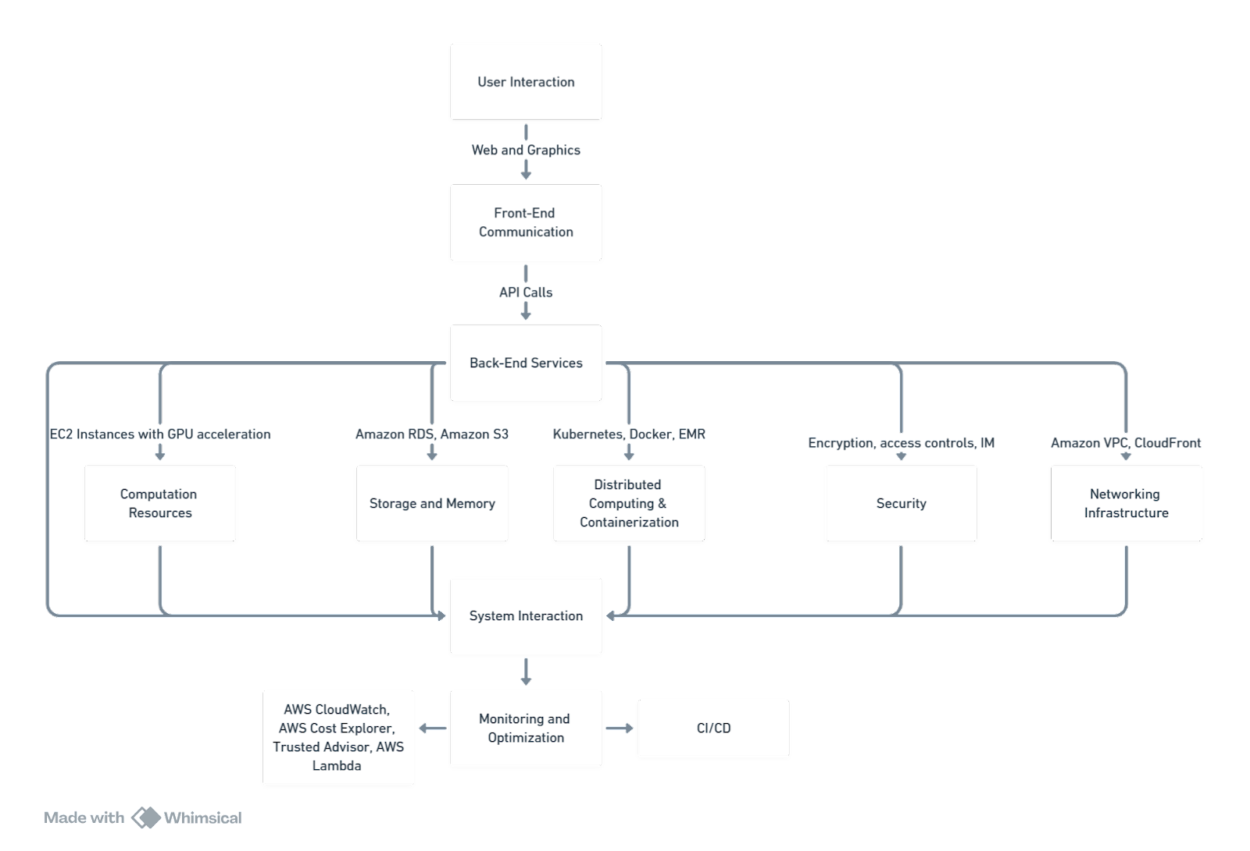
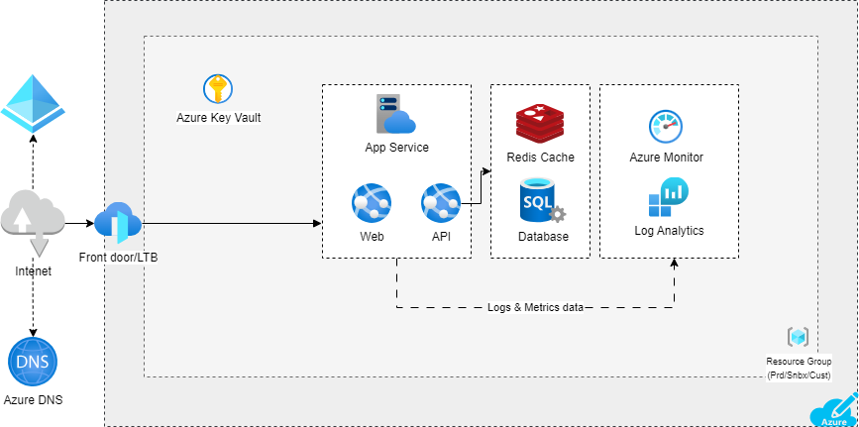
The financial literacy app leverages a robust tech stack combining React.js for web, React Native for mobile, and a Node.js backend for seamless cross-platform performance and efficient real-time data processing. Data management is powered by PostgreSQL, ensuring secure and scalable storage for sensitive financial information. Integrations with APIs like Plaid and Alpha Vantage enable real-time financial tracking and market data access. Hosted on Microsoft Azure, the app ensures scalability, reliability, and advanced analytics, delivering a responsive and secure user experience.
Tech Stack and System Interaction

Slide 8
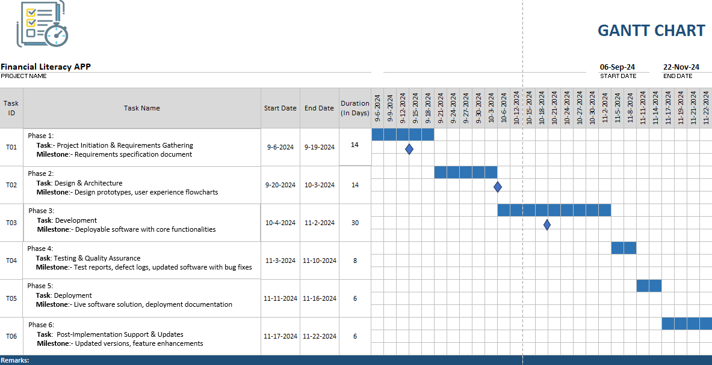
Project Plan Overview

Slide 9
Risk Management Overview
Technical Risks:
Financial literacy Implementation Challenges
Scalability Concerns
Data Security
Content Development Challenges
Operational Risks:
User Engagement
Content Management
Technical Support
Community Building
Economic Risks:
Budget Constraints
Monetization Strategy
Market Competition
Legal and Compliance Risks:
Data Privacy Regulations
Intellectual Property Rights
Accessibility Compliance
User Experience Risks:
Usability Issues
Feedback Mechanisms
Content Relevance

Slide 10
Budget Overview
The total budget for the Financial Literacy App is $1.44 million, primarily allocated to development costs ($1.38 million), infrastructure hosting on AWS ($35,212), and marketing efforts ($22,000). The development budget covers salaries for a skilled team of developers, designers, and testers, while the infrastructure ensures secure and scalable cloud hosting. Marketing focuses on targeted ads and influencer partnerships to maximize user acquisition and app visibility.

Slide 11
Resource Allocation & Contingency Budget
Resource Allocation
Personnel:
Development Team (12 Members): Focused on creating core functionalities, integrating APIs, and implementing advanced features like gamified modules and investment simulators.
QA Engineers (4): Dedicated to rigorous testing to ensure a secure, bug-free application.
DevOps Engineers (2): Responsible for managing cloud infrastructure, ensuring scalability and uptime.
Infrastructure:
Hosted on AWS, leveraging scalable solutions for storage, database management, and real-time processing needs.
Marketing:
A mix of paid advertisements, social media campaigns, and influencer partnerships to maximize user acquisition and app awareness.
Market Response
Risk Management
External Dependency Failures
Scope Changes
Human Resources
Contingency Budget
The $25,000 contingency budget is designed to mitigate risks such as:
Unexpected API pricing changes.
Additional marketing spend required for user acquisition.
Emergency bug fixes or performance optimizations during peak usage.

Slide 12
Conclusion and Call to Action
Market Feasibility: Growing demand for digital learning solutions
ROI: Demonstrated financial viability and sustainability
Risk Mitigation: Prepared to navigate challenges with resilience
Vision: Shaping the future of financial education together
Let’s Achieve the Financial Independence Together!

